Slide 1
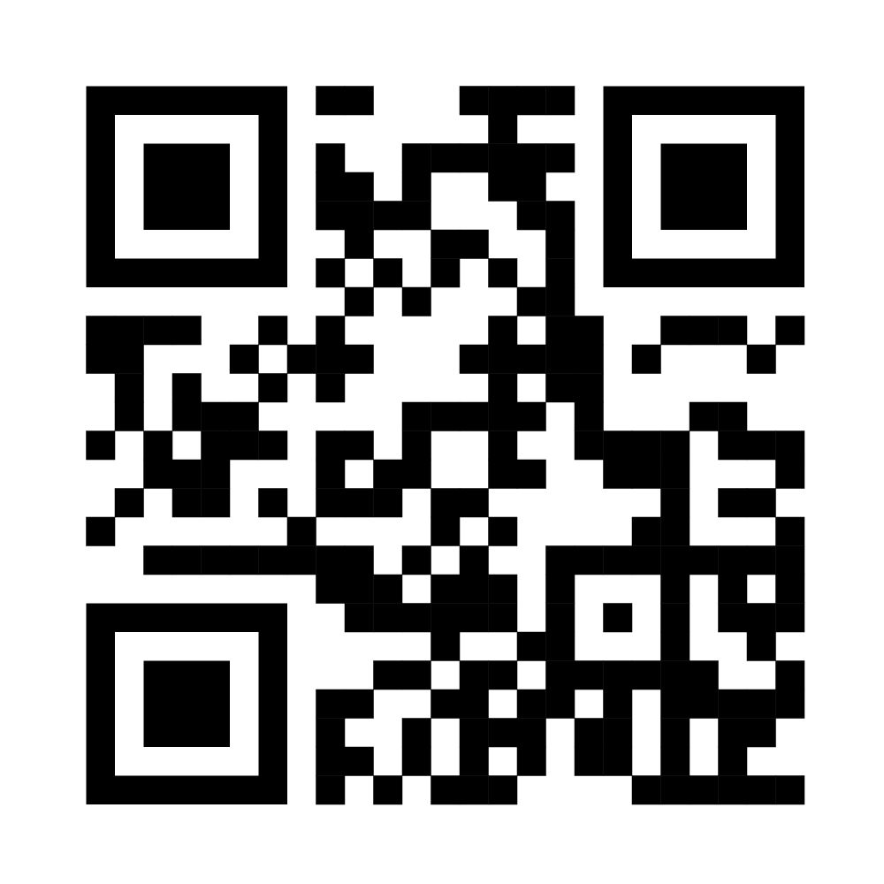
Maxillofacial Surgery Affecting
Children and Young Adults
£45 early sign up before Valentine's day
£60 after 14th Feb
Potentially win more than your money back with the poster prize
DoubleTree Hilton, Leeds City Centre
Friday 9th May 2025
QR code and link
to register
BAOMS
Fellows in Training Conference 2025
“Next-Gen Healing: Surgical Innovations for the Future of Our Youth”
https://docs.google.com/forms/d/e/1FAIpQLSekwlpkOjAn-62Or-Nno0Go3hxKhth9NihiCuGmPJwbdx0vSQ/viewform

Slide 2
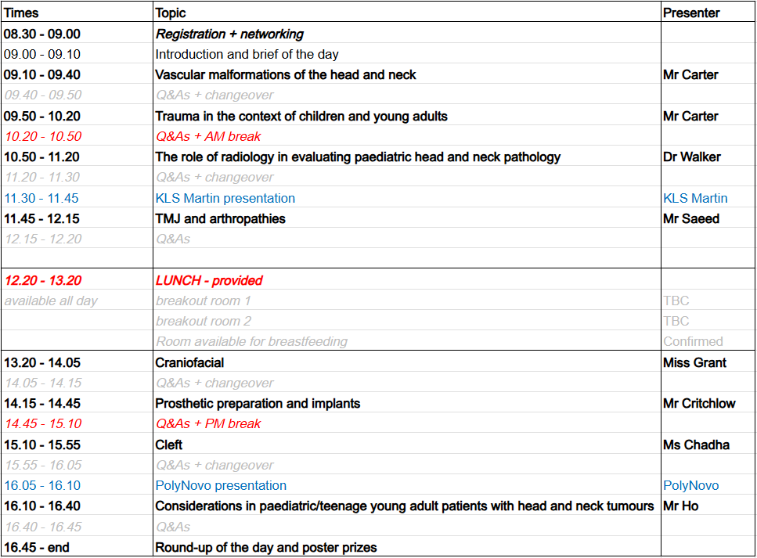
FiT Conference timetable
Poster entry specification:
Anything, preferably on paeds/young adult theme
Prizes:
1st place £100 Amazon gift card
2nd place £50 Amazon gift card
Free lunch, teas and coffees
Networking with fantastic speakers
Potentially free dinner in the evening

